Slide 1
LABORATORY SAFETY

Slide 2

During your working in the Lab you must take care about the followings:
Yourself: keep your body out of any injuries or accidents and your Health
out of any bad effect.
Your classmate: you must watch your safety and the safety of others
The lab.: keep your working space cleaned and organized during and
after you complete your work, the lab. free of any accident, and
the lab. environment without any pollution.
Outdoor Environment: keep it free of any pollution.
Your experiment: do your experiment carefully and don’t hesitate to ask
your instructor about anything you are not understand.

Slide 3
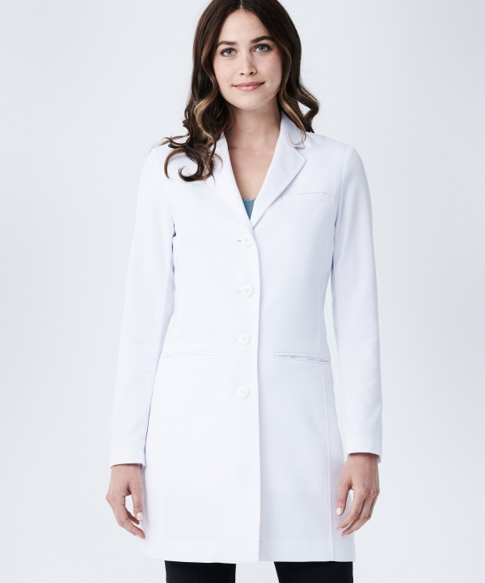
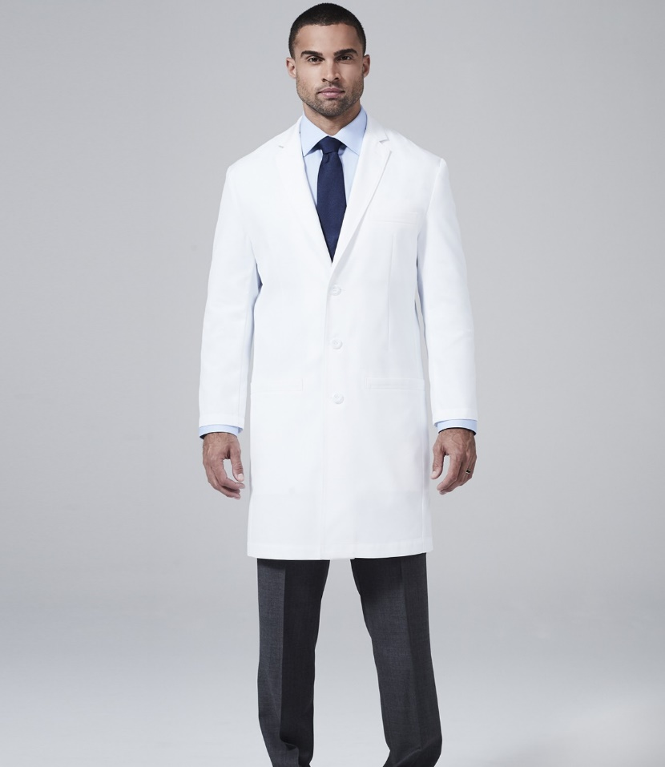
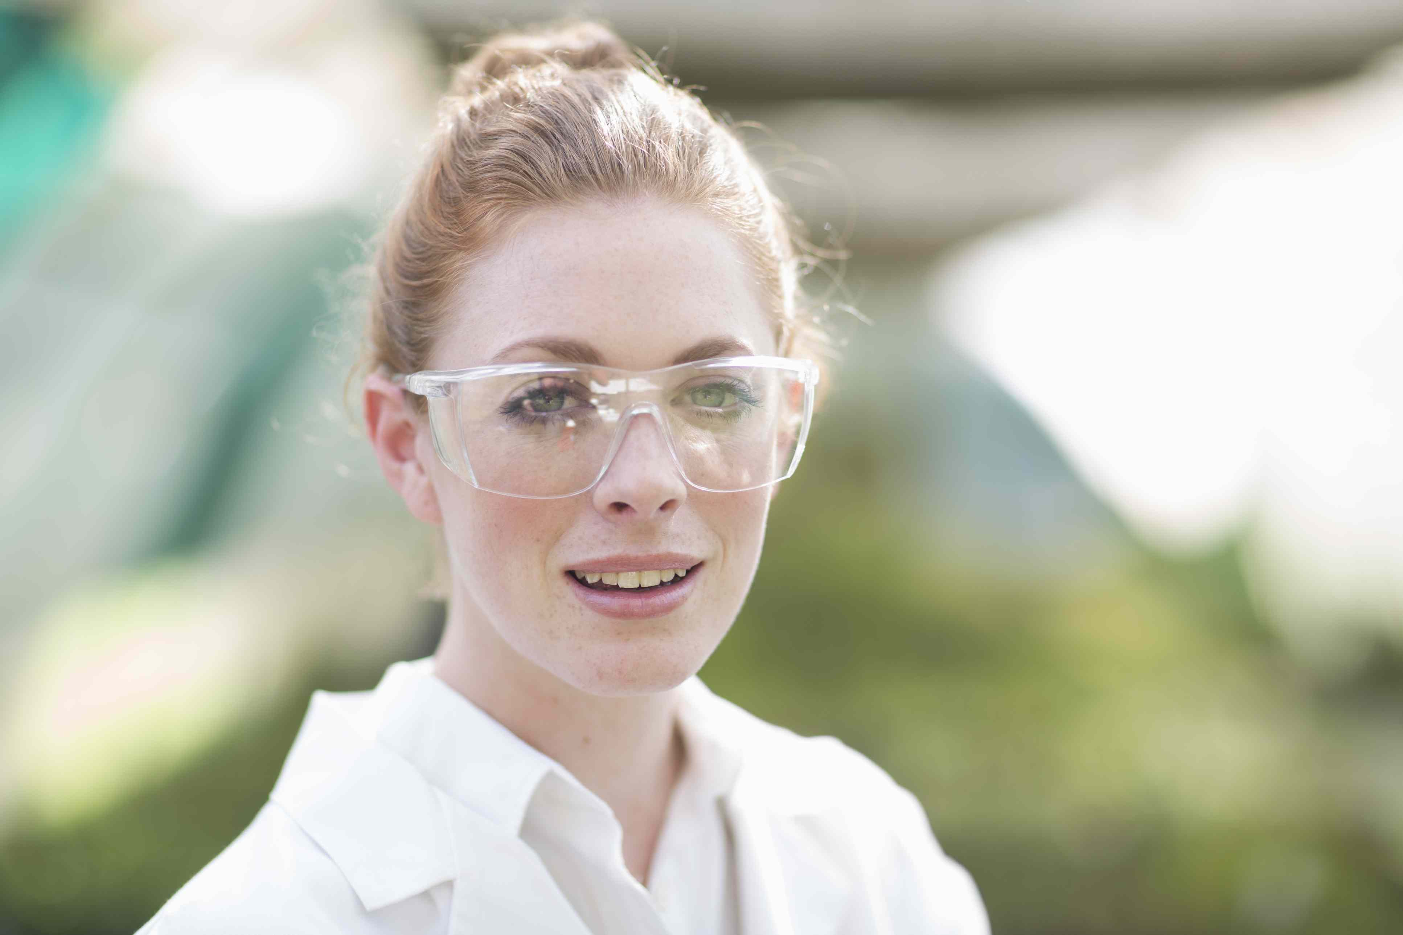
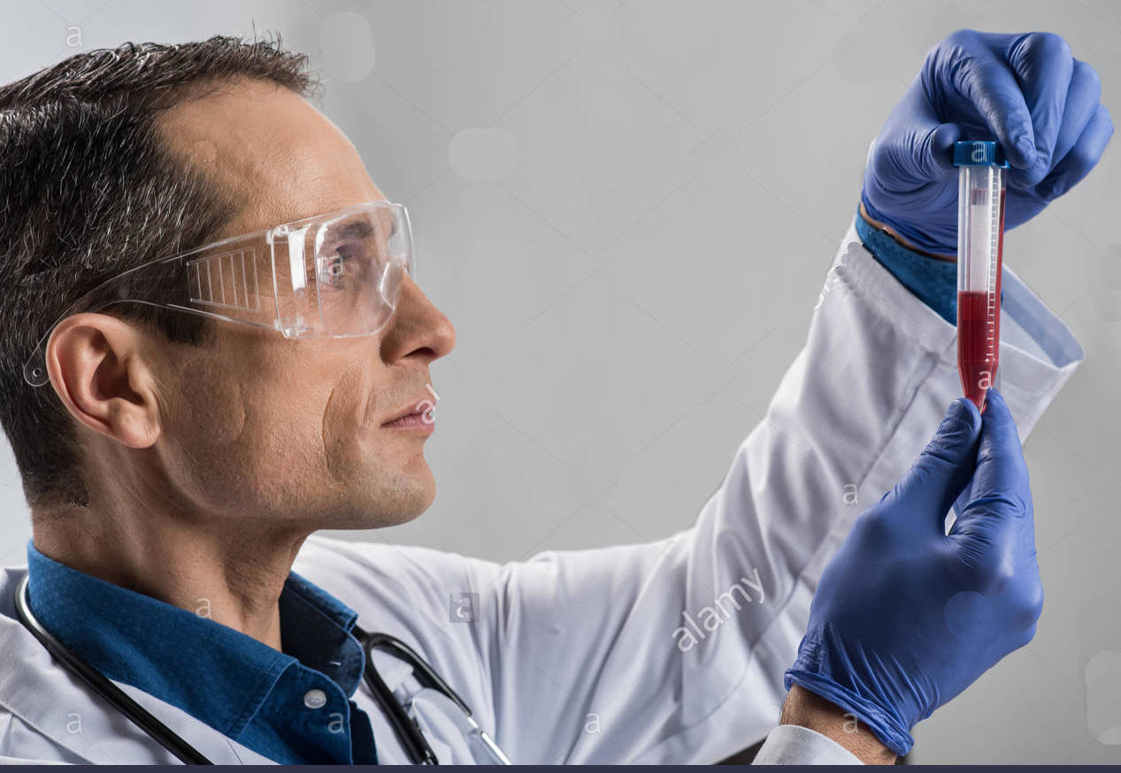
* For any science lab, dressing of the following clothes is one of your best forms of protection against an accident: A) Dress the lab. coat while you are in the lab. and it must be closed. B) wear covered shoes, long pants, and tie your hair backward up. So, it can't fall into your experiment or a flame. C) Dressing of goggles, You may also need gloves, hearing protection, and other items, depending on the nature of the experiment.

Slide 4
Why following the Laboratory rules is the most important?
If you don't follow it:
* You endanger yourself and others in the lab.
* You could easily ruin your experiment.
* You put the lab at risk of an accident, which could damage equipment as well as harm people.
* You could get suspended (student) or fired (researcher).

Slide 5
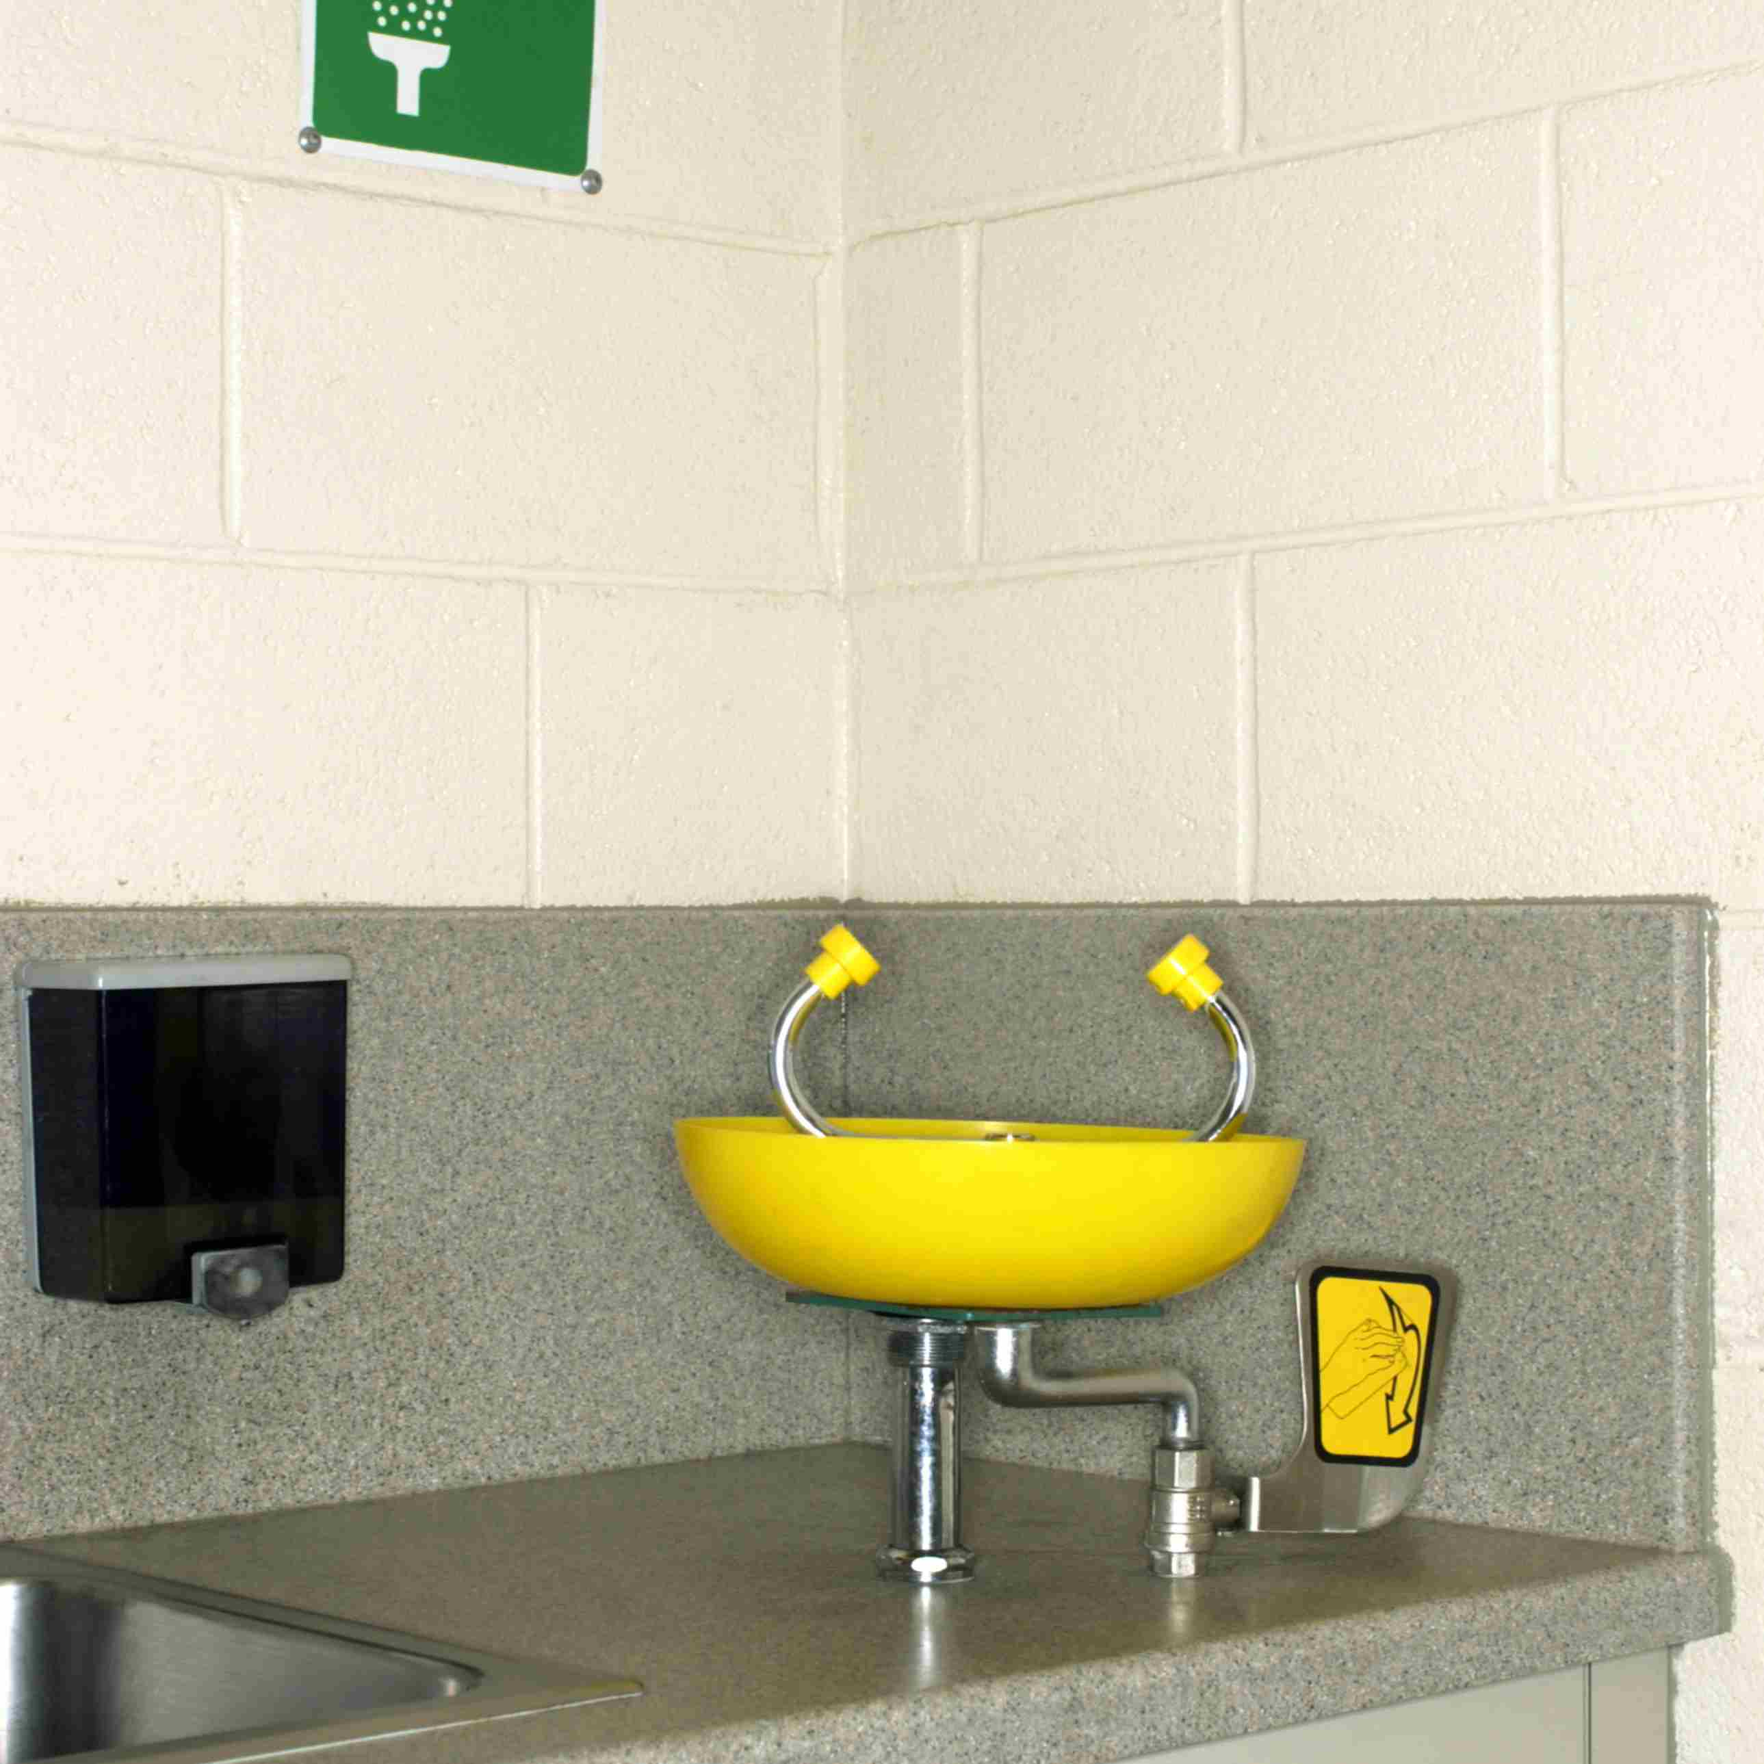
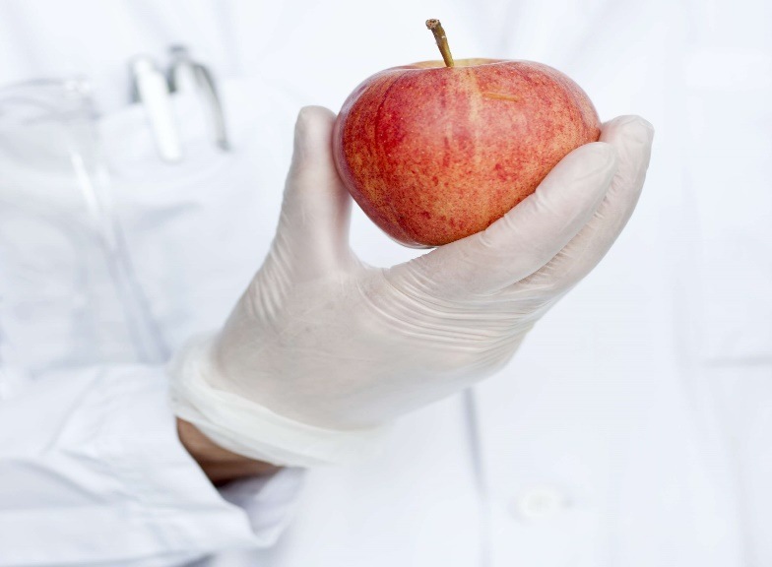
General Rules
* Know the Location of Safety Equipment
* Drinking, eating and chewing are prohibited in the lab. It may be
poisonous for you.

Slide 6
* Work quietly — know what you are doing by reading the assigned experiment before you start to
work.
* Keep solids out of the sink.
* Do not lean, hang over or sit on the laboratory tables.
* Know emergency phone numbers to use to call for help in case of an emergency.
* Do not lift any solutions, glassware or other types of apparatus above eye level.
* Follow all instructions given by your teacher.
* Do not work alone in the lab.
* Make sure you always follow the proper procedures for disposing lab waste.
* When handling any toxic or hazardous agent, always wear the appropriate gloves.

Slide 7
* After performing an experiment, you should always wash your hands with soap and water.
* When using lab equipment and chemicals, be sure to keep your hands away from your body, mouth,
eyes, and face.
* Don't perform your own experiments unless given permission
* Immediately report any accident or injury to your instructor or supervisor
* Clean up and decontaminate your workspace before and after the Lab.
* Learn and follow the lab rules for proper disposal of hazardous materials and sharp objects like
needles, scalpels, and broken glass.

Slide 8
Using of fire:
* Open flames should never be used in the laboratory unless you have permission.
* An area of 36" diameter must be kept clear at all times around all fire sprinkler heads.
* If there is a fire drill, be sure to turn off all electrical equipment and close all containers.
* Anyone wearing acrylic nails will not be allowed to work with matches, lighted splints, bunsen
Burners, etc.
* Don’t leave any heated materials unattended

Slide 9
Glassware:
* Laboratory glassware should never be utilized as food or beverage containers.
* Correct eye protection should be worn in most experiments involving glassware.
* Each time you use glassware, be sure to check it for chips and cracks.
* Broken and other waste glass should be discarded in a separate container

Slide 10
Instruments:
* Never use lab equipment that you are not approved or trained by your supervisor to operate.
* Don't operate lab equipment without permission
* Use lab refrigerators, freezers, ovens, and storage units only for their intended purposes, but not use
for your personal food and drink or storage.

Slide 11
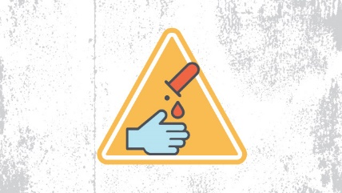
Chemical Safety Rules
The best way to remain safe when dealing with chemicals is to assume that any chemical you handle is dangerous and you must know how to handle it.
* Never lift any glassware, solutions, or other types of apparatus above eye level.
* In the event of a chemical splashing into your eye(s) or on your skin, immediately flush the
affected area(s) with running water for at least 20 minutes and inform your lab instructor.
* Do not allow any solvent to come into contact with your skin.
* Read carefully the label and the direction on the bottle before use it.
* Never take more chemicals from a bottle than you need for your work.
* Do not put unused chemicals back into their original container.

Slide 12
* Chemicals should never be mixed in sink drains.
* Flammable and volatile chemicals should only be used in a fume hood.
* Ensure that all chemical waste is disposed of properly as indicated by your instructors.
* Don't use single pipette for more than one chemical.
* Don't use your mouth for pipetting substances.
* Don't taste or Sniff any chemicals or substances you are working with.
* Don’t pour chemicals down the drain without permission.

Slide 13
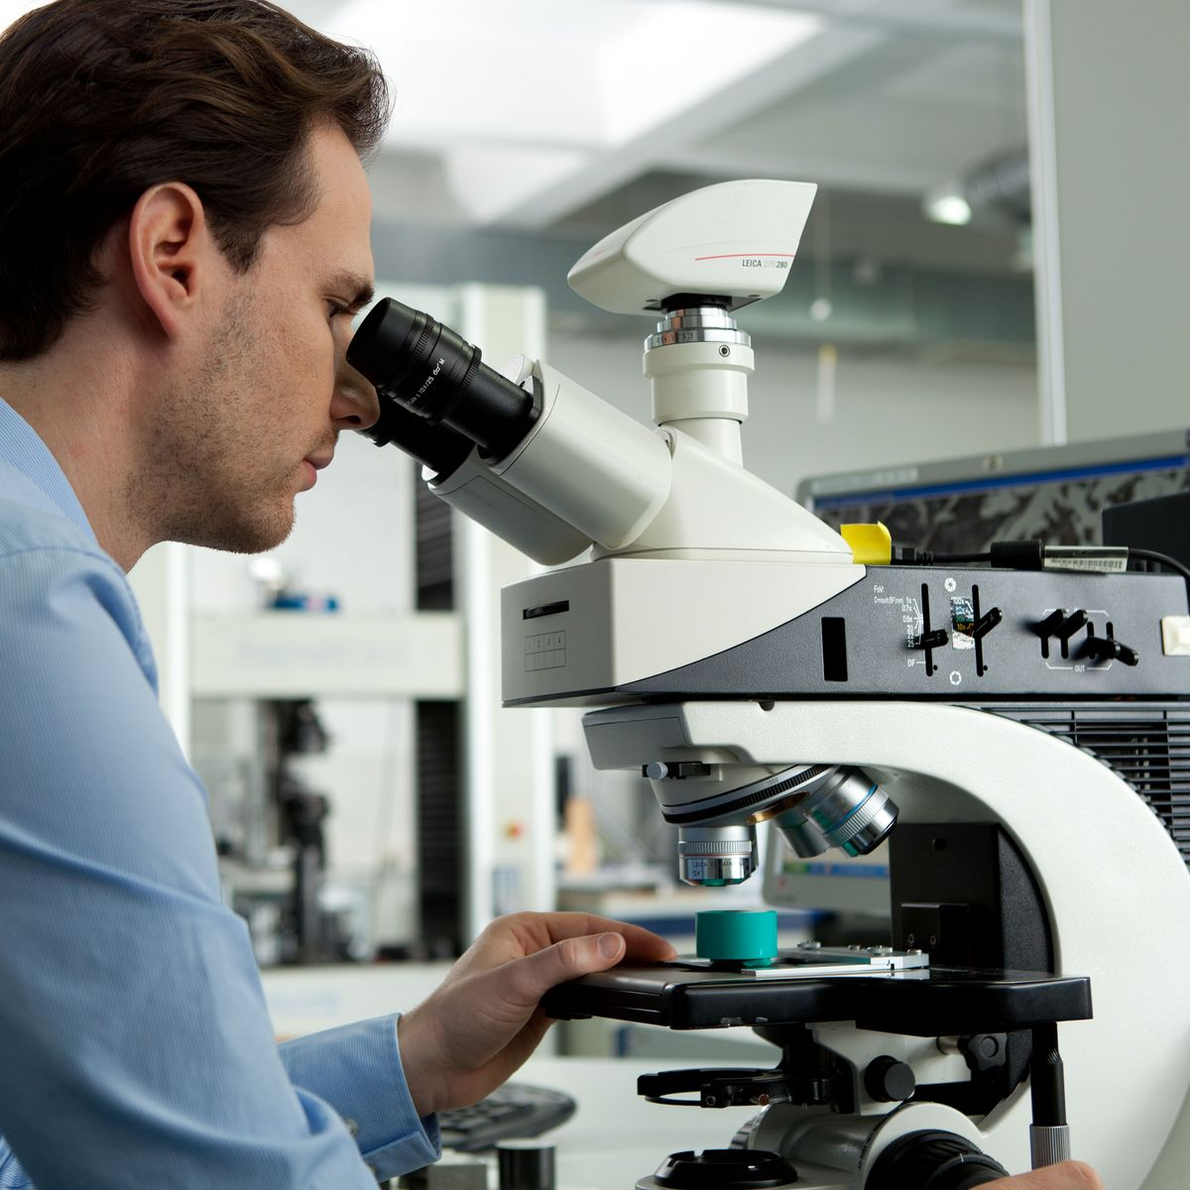

The Microscopes

Slide 14
The Microscopes
MICROSCOPE: is an instrument used to see objects or parts of the object that are too small to be
seen by the naked (unaided) eye.
Concepts of the microscopes:
Magnification: It is the ratio of the size of the image to that of the object
Total magnification= Magnification of ocular lens X Magnification of objective lens
Contrast: the ability see a particular details against its background. We can use
stain to increase it.
Resolution: the ability of a microscope to show two closely lying points as two distinct
points. It increases with magnification.

Slide 15
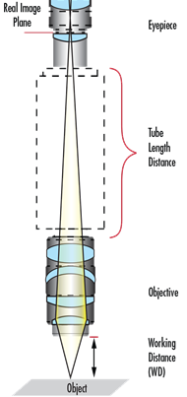
Microscopic field: the part of the specimen that can be seen under the microscope.
It decreases with magnification.
Working distance: the distance between the objective lens and the specimen.
It decreases with magnification.
M1 X DFV1 = M1 X DFV1
M1 : Magnification of the first objective lens
DFV1: Diameter of the field of view with first objective lens
M1 : Magnification of the second objective lens
DFV1: Diameter of the field of view with second objective lens

Slide 16
The microscopes may be:
* Simple microscopes: is generally considered to be the first microscope. It
combined a convex lens with a holder for specimens
and Magnify between 200 and 300 times.
* Compound Microscopes: Two lenses, the second lens magnifies the image of the first.
and they may be binocular or monocular. These devices
provide a magnification up to 1200 times, but the resolution is
low.

Slide 17
Types of Microscopes
Based on what interacts with the sample to generate the image
Optical Microscopes: Use visible or invisible light to create image,
Compound Microscopes:
- The specimen is then magnified by a series of lenses,
one near the slide (called the objective lens) and one
near the top (called the eyepiece).
- The light lit the specimen from underneath
- Two-dimensional image
- Magnify up to 1200 X
- Low resolving power
Stereo Microscopes :
- The specimen is usually lit from above
- Use with any opaque specimen
- Create three-dimensional images
- Low magnification ( 10X – 50X)
- Lower resolutions than compound microscopes

Slide 18
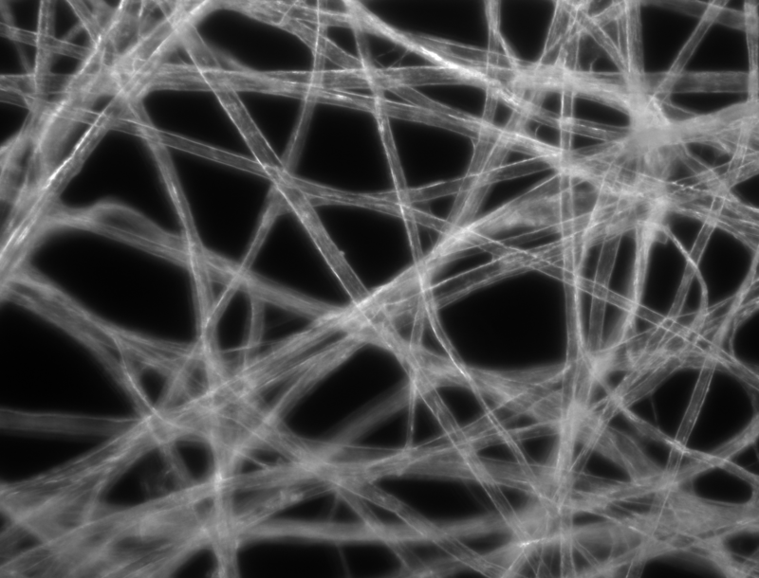
Phase contrast microscope:
- Light object is seen in dark background
- low magnifications (up to 100x)
- Use to view everything in a liquid sample,
debris and all
- The light lit the specimen from underneath,
but a special condenser blocks this light so
that only oblique rays hit the object.
Laser scanning confocal microscope:
- Laser beams emitted from the laser light
source go through the objective lens to scan
a sample. The fluorescence of the sample
reflected from the focal plane, and then
visualize the resulting data with a computer
- high-resolution images
- High contrast

Slide 19
Fluorescence microscope:
- use invisible light such as UV light, when UV light hit specimen stained with
fluorescent dye it will emit visible light with increase in the resolution of the
object.
- Allows observation of fluorescence images.
- It is possible to only observe specific areas by using different fluorescent
labels.
Electron Microscope: - Use a beam of electrons to form image.
- Use electromagnetic lenses instead of glass lenses
- Very high resolving power
- Two types:
Transmission electron microscope (TEM):
Give ultrastructure of the cell
Give 2D image
Total magnification (over 20 millions X)

Slide 20
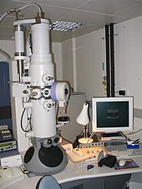
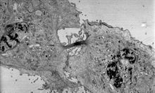
Transmission electron micrograph of a dividing cell undergoing cytokinesis
TEM

Slide 21
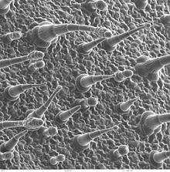
Scanning electron microscope (SEM):
Give topography image for the surface of the cell
Give 3D image
Total magnification (over 20,000X)
Leaf surface viewed by a scanning
electron microscope

Slide 22
X-ray Microscope :
- Use a beam of X-rays to create image
- Resolution higher than that in optical microscope
Scanning Acoustic Microscope:
- Employs sound waves to create image

Slide 23
DURING USING OF THE MICROSCOPE YOU MUST TAKE CARE ABOUT THE FOOLOWINGS:
ALWAYS CARRY THE MICROSCOPE WITH TWO HANDS, ONE UNDER THE BASE, THE OTHER HOLD THE ARM, AND THE MICROSCOPE MUST BE UPRIGHT PARALLEL TO YOUR BODY.
PUT THE MICROSCOPE GENTLY ON THE BENCH AND AWAY FROM THE EDGES.
DO NOT DRAG OR SHOVE THE MICROSCOPE ACROSS THE LAB BENCH.
SWITCH ON/OFF THE MICROSCOPE FROM THE MICROSCOPIC SWITCH, NOT FROM THE MAIN
ELECTIC SWITCH.
CLEAN THE MICROSCOPE BEFORE AND AFTER USE IT ONLY BY LENS PAPER.
* The first for all optical parts of the microscope EXCEPT oil immersion lens, starting
from eyepiece, objectives, condenser, then light source.
* The second for oil immersion lens only.

Slide 24
At the end of using the microscope do the followings:
Clean the microscope
Lower the stage to the lowest point
Put the scanning objective lens (4X) at the position (over the condenser)
Tie the electric wire around the arm in a tidy way.
Return the microscope to the cabinet
Put the microscope in the cabinet in such a way that the microscopic arm faced out.

Slide 25
Parts of the compound microscope (Student Microscope):
THE INSTRUCTOR MUST SHOW THE PARTS OF THE COMPOUND MICROSCOPE PRACTICALLY TO THE STUDENTS WITH THEIR FUNCTION
AS IN THE FOLLOWING PICTURE

Slide 26
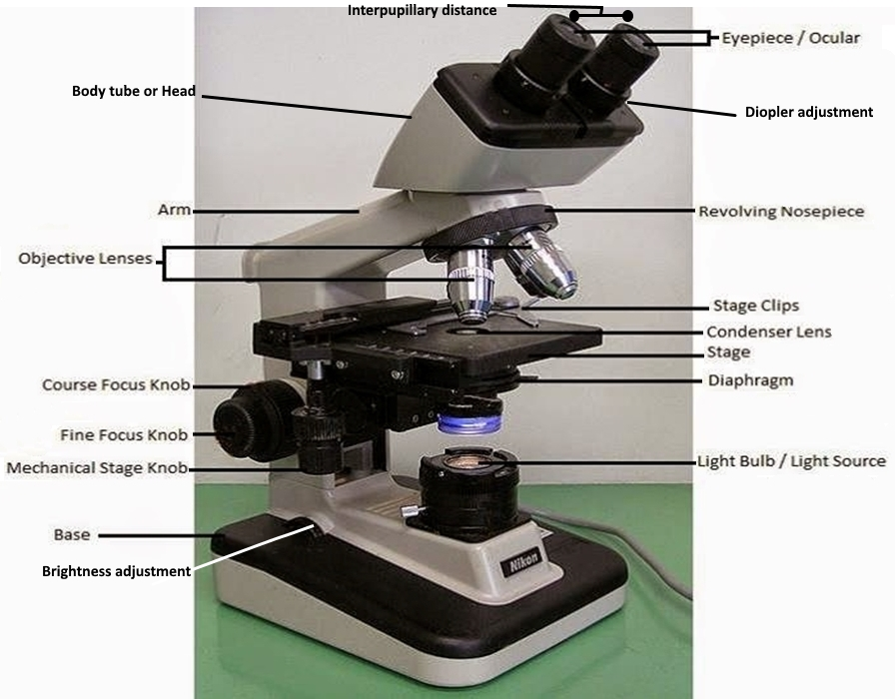
Parts of the Compound Microscope

Slide 27
Objective lenses:
Dry objective lenses: Scanning (4X), 10X, 40X
Wet objective lens: may be one or two (100X)

Slide 28
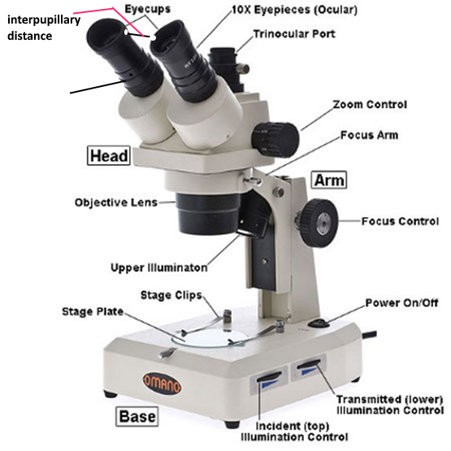
Parts of the Dissecting Microscope

Slide 29
Viewing of a specimen under Compound Microscope
The instructor should show the students practically How to focus the specimen under the Microscope.
During focusing the specimen you must take care about the following:
Fix the slide by stage clip
Put the light spot at the center of the specimen
Lower the stage to the lowest position
Start with the lowest light intensity
Start with scanning objective lens (4X)
After you see the image under certain lens move the slide by adobe knob to check if what you see
is the image of the specimen and to center the specimen
Don’t lower the stage from the starting point of focusing up to seeing the image under oil immersion

Slide 30
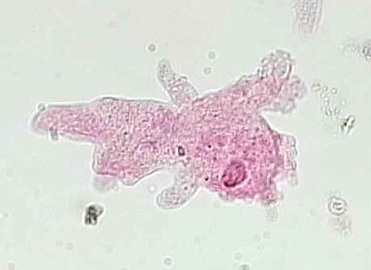
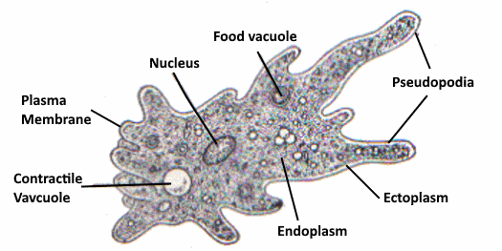
Ameoba

Slide 31
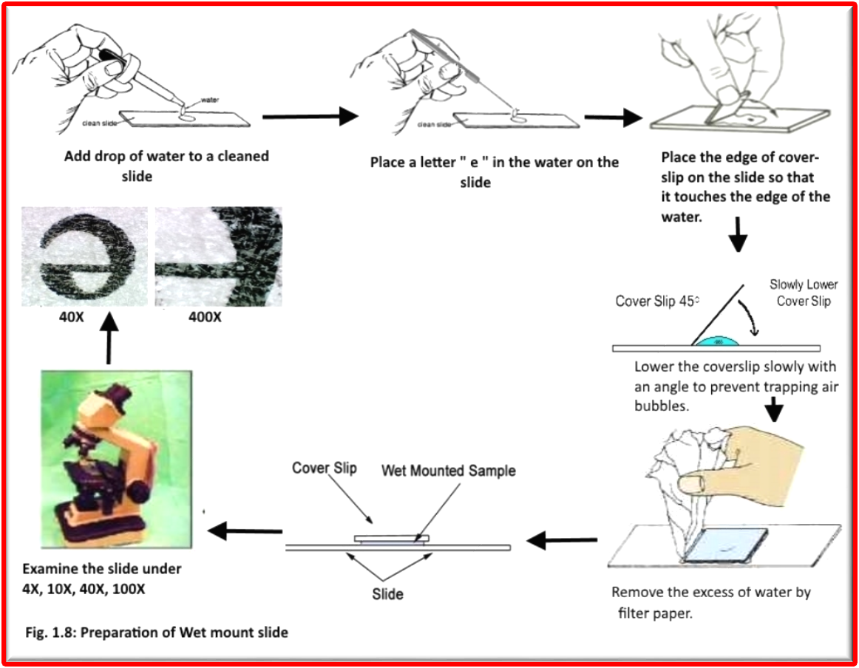
Preparation for a wet mount of letter “ e “

Slide 32
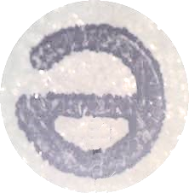
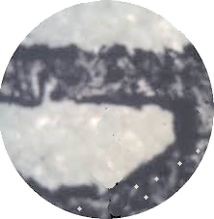
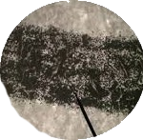

Preparation for a wet mount of letter “ e “
Take care about the following when you the letter “e”
Magnification
Inverted upside down
Resolving power
Put letter “ e “
Under the microscope in a readable way
40 X 100 X 400X

Slide 33
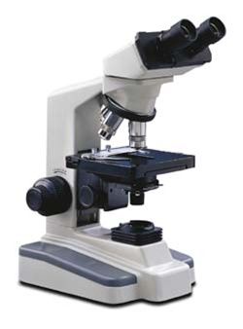
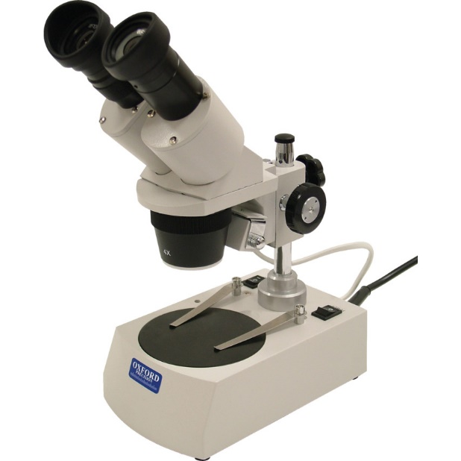
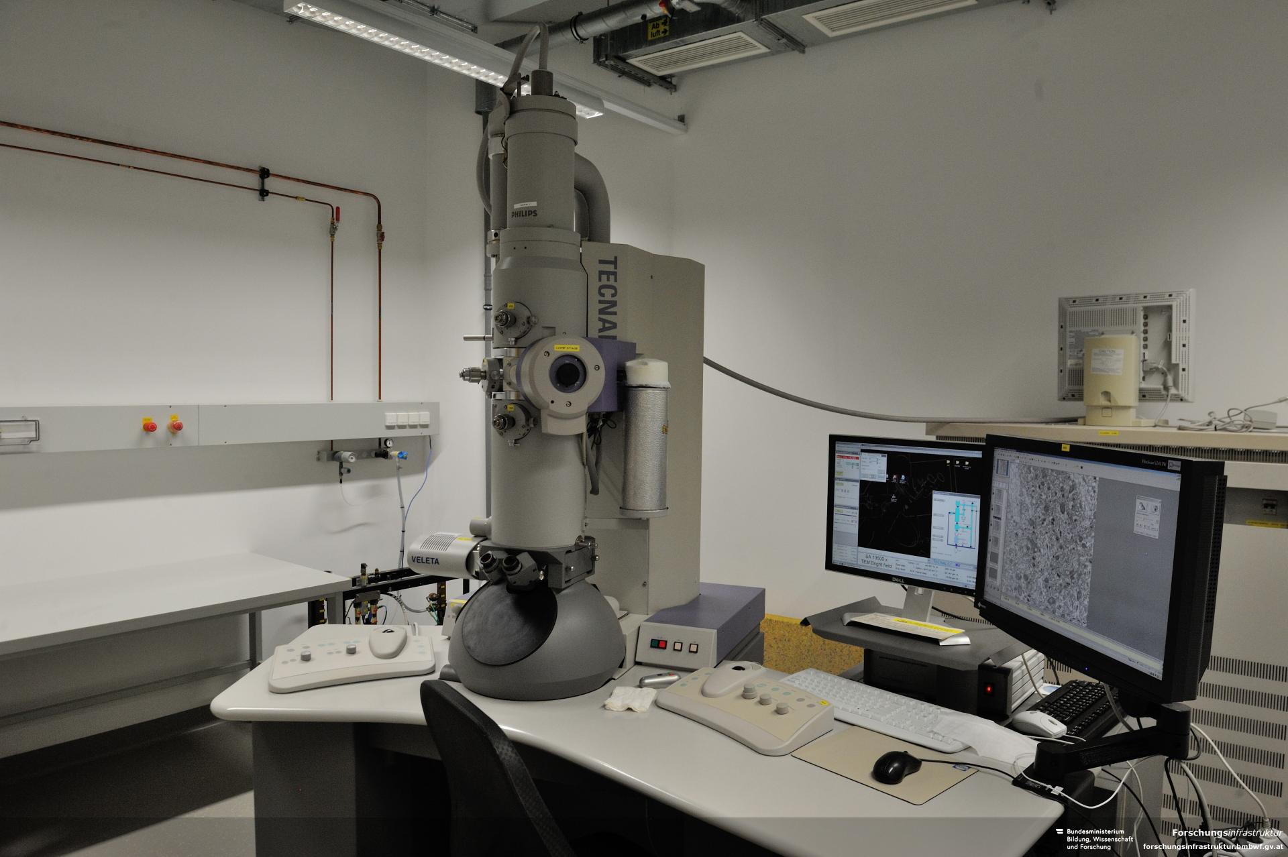
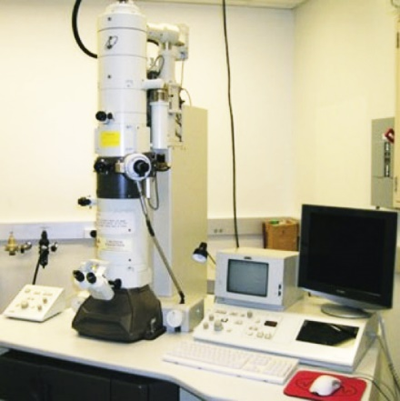
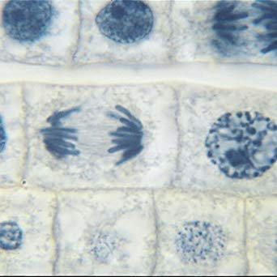
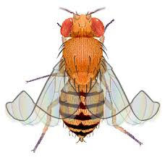
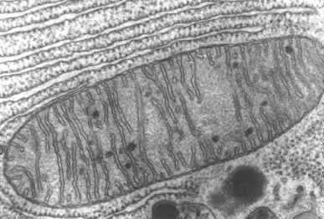
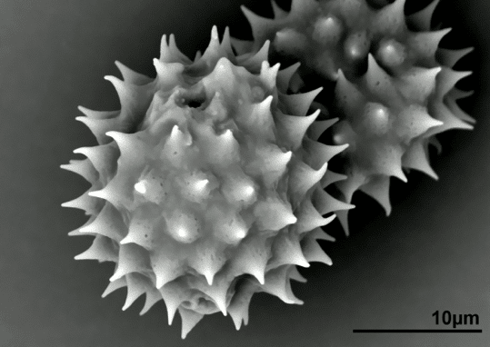
Compound Dissecting TEM SEM

